Slide 1
Sentence Writing

Slide 2
Why?
Because……
So that……
But……

Slide 3
When?
Today……
Yesterday…..
Tomorrow……
A long time ago…..
On the weekend…..
On Monday……
This morning…..
Last night……
At lunch time…..
One day…..

Slide 4
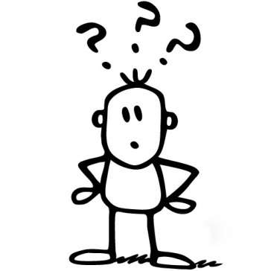
What?
went……
saw…..
had……
played…..
got…..
bought…..
come…..
liked……
looked…..
watched……
said…..
ran…..
made…..

Slide 5
Who?
I……
My sister/brother…..
My family……
My friend…..
Our class…..
Some children……
An old man…..
The boy……
A dog…..

Slide 6
Where?
At home……
At school…..
At the park……
At my friend’s place…..
In Albury…..
In Melbourne……
In Sydney…..
In the river……
In the sea…..
At the beach…..

Slide 7
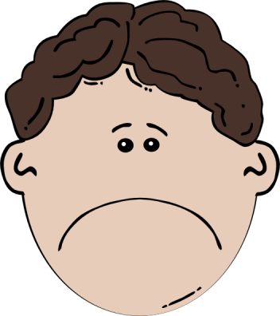
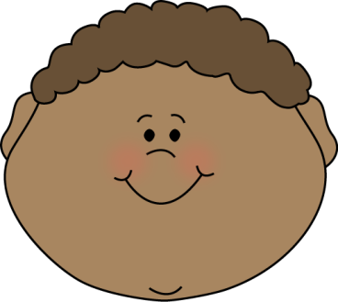
How did you feel?
Happy……
Sad…..
Angry……
Surprised…..
Excited…..
Worried

Slide 8
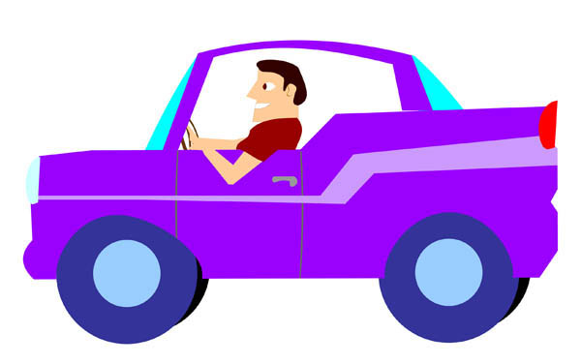
What happened next?
After……
Next…..
and then……
In the end…..
Finally…..

