Slide 1
Writing a Sentence

Slide 2
Who?
I
Mum
Dad
An old man
The boy
A dog
My sister
My brother
My friend
Our class
Some children

Slide 3
Where?
At home
At school
At the park
At Grandma’s
Near the river
At the pool

Slide 4
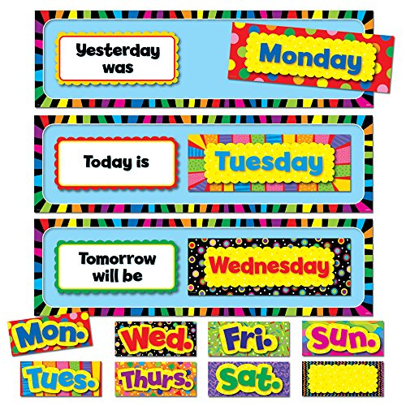
When?
Today
Yesterday
Tomorrow
A long time ago
On the weekend
On Monday
This morning
Last night
One day
At 3 oc’lock
Once upon a time

Slide 5
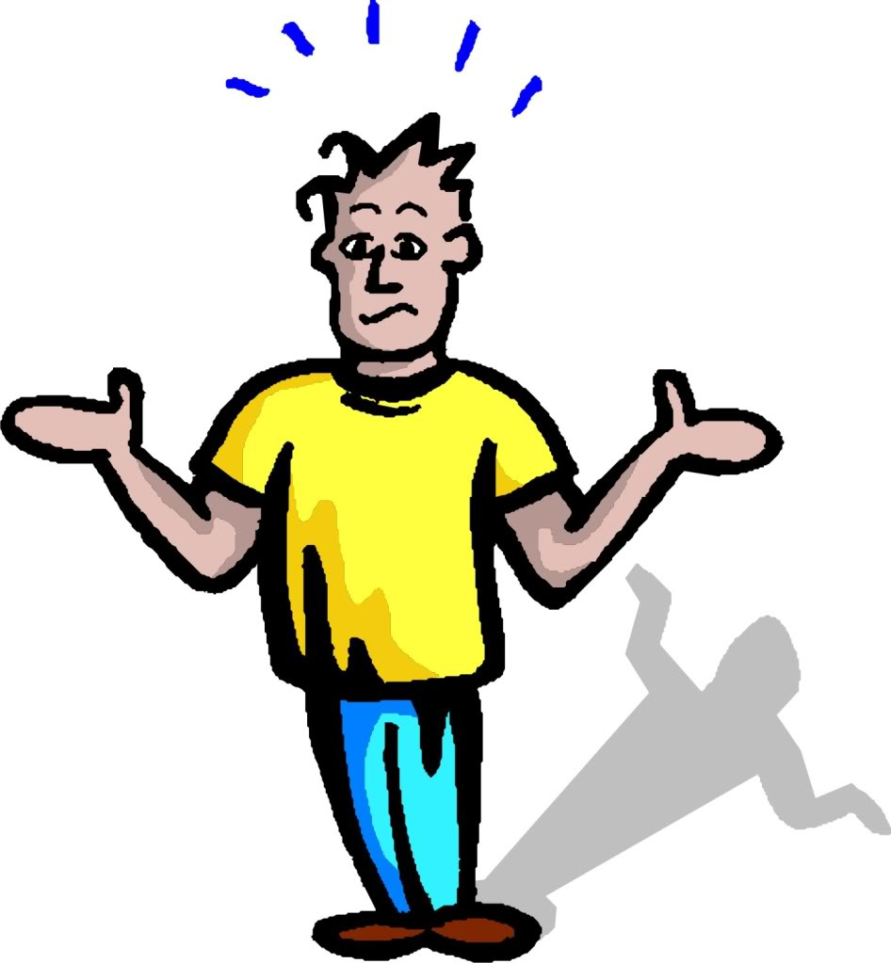
Why?
because
so that
but
and

Slide 6
How did you feel?
happy
sad
angry
surprised
excited
worried

Slide 7
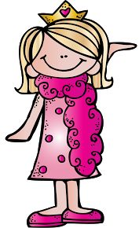
What?
went
saw
had
played
got
bought
came
liked
looked
watched
said
ran
made

Slide 8
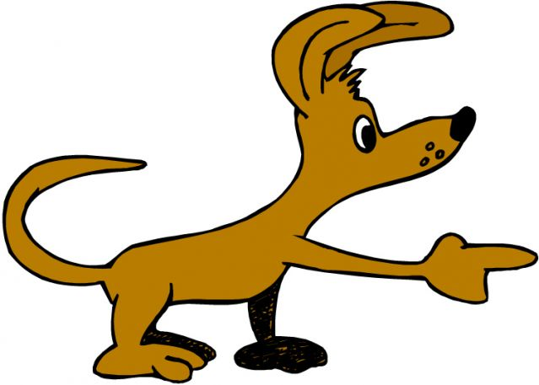
What happened next?
after
next
in the end
finally
and then

