Slide 1
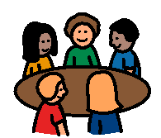
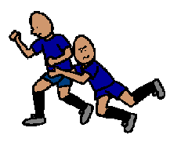
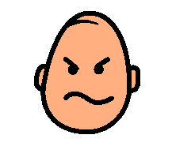
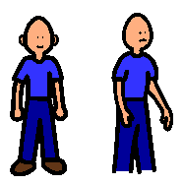
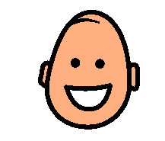
WHEN SOMEONE BOTHERS ME
When someone bothers me in the classroom
or in the playground
I look at them with my angry face.
I say, “No! Don’t do that! I don’t like it!”
Then I turn away.
When I do this they will stop bothering me and my friends and teachers will be happy.
No! Don’t do that.

