Slide 1
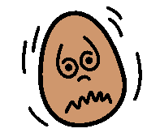
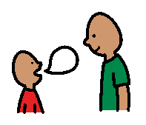
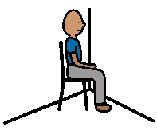
When I’m
Confused Not Understood Angry
Tell someone what’s wrong (use my words)
Ask for help
Ask for a break
Stay in class or work in a quiet place
Teacher is happy
Parents are happy
I CAN
THEN
Throw things
Hit people
Kick people/things
Run away
Time Out chair
Teacher is unhappy
Parents are unhappy
I CAN’T
THEN

