Slide 1
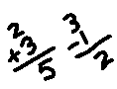
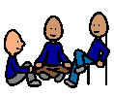
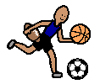
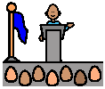
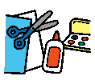
Today at school I did….
maths
reading
talking
sport
library
art
assembly
computer
writing
listening
drawing
craft
play
spelling
activities
colouring
worksheets
HSIE
singing
working
I was good at….
sharing
listening
waiting
taking turns
playing
working
I felt….
happy
sad
excited
angry
sick
tired
Comment

