Slide 1
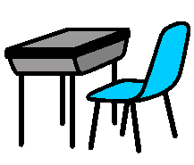
TAKING CARE OF PROPERTY
TAKING CARE OF PROPERTY
I take care of my things. I hang up my bag.
I put my name on all my property. I put things in my bag.
I look after school property by taking care and putting it away.
I treat my classmates’ things with care. I give things back.
When I take care of all property everyone is happy.

