Slide 1
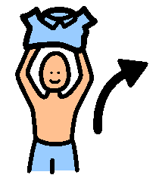
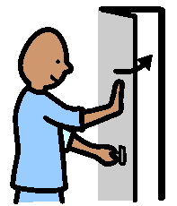
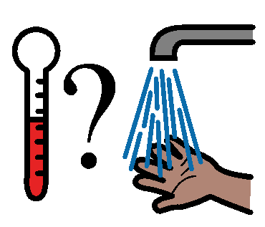
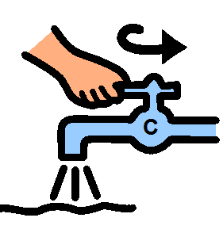
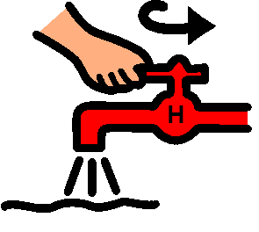
TAKING A SHOWER
1
2
3
Get pyjamas and towel and put on a rack.
Turn on bathroom light and close the door.
Get undressed.
4
5
6
Stand back from the shower.
Turn on the cold water, then the hot.
Check the water. Is it just right?

Slide 2
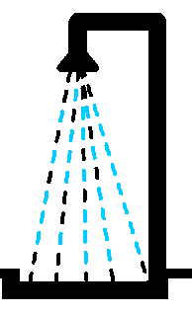
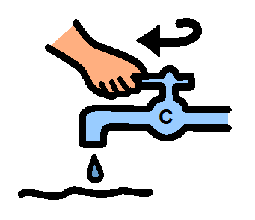
7
8
9
Get into the shower. Get the soap and sponge.
Make yourself all soapy.
Wash off the soap. Now I am clean.
10
11
12
Turn off the hot water.
Turn off the cold water.
Step out of the shower SLOWLY.

Slide 3
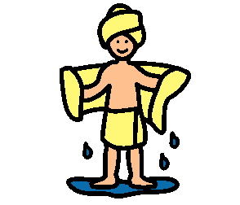
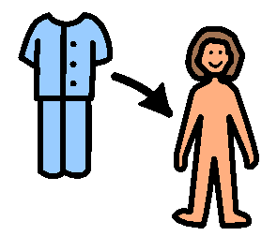
13
14
15
Get your towel and dry yourself.
Put your pyjamas on.
Hang up your towel.
16
My family will be happy that I can shower myself.

