Slide 1
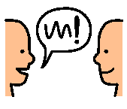
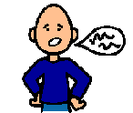
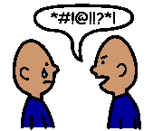
SWEAR WORDS
1
Talking is usually good. People like to talk to each other.
2
Most words can be used at any time. Some words are more polite than others.
word
3
Swear words are words that people might say when they are angry or fooling around. Sometimes students use them in the playground.
4
Sometimes when people hear swear words they feel insulted. Sometimes people who hear swear words will be sad and upset.

Slide 2
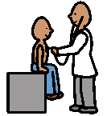
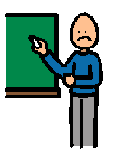
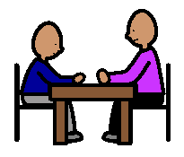
5
These are places where swear words are not okay.
6
Using swear words in class will often make teachers upset.
7
People who use swear words in school might get detention.
8
It’s a good idea to leave swear words out of conversations.

