Slide 1
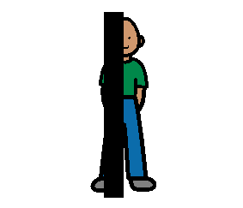
in
out
on
under
next to
between
off
in front
behind

