Slide 1
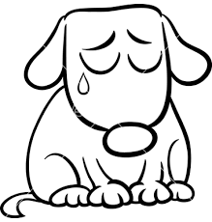
My Tasks for Today
My Tasks for Today
Today I’m going to try to__________
__________________________________
by ______________________________.
Each time you remember, colour the smiling cat. When you forget, colour the sad dog.
Today I’m going to try to__________
__________________________________
by ______________________________.
Each time you remember, colour the smiling cat. When you forget, colour the sad dog.
I remembered______times.
I forgot________times.
I remembered______times.
I forgot________times.

