Slide 1
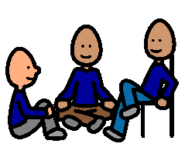
MY CLASSROOM VOICE
When I am talking in class I use a quiet voice – a class room voice.
When I want to ask my teacher a question I put up my hand and use my classroom voice.
When I want to interrupt, I say “Excuse me” and use my classroom voice.
When I want to talk to my friends in class I use my classroom voice. My friends don’t like it when I yell at them.
When I want to say no or disagree I use my classroom voice and I don’t yell.
When I use my classroom voice and I don’t yell my friends and teachers will be happy and will like talking to me.

