Slide 1
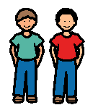
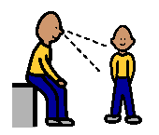
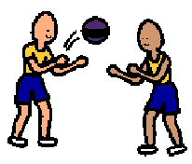
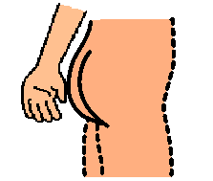
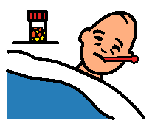
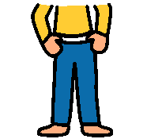
Having Good Manners
I make friends at school.
I like to watch my friends.
I can play with my friends.
It is bad manners when I put my hands down my pants and touch my bottom.
I might get sick from touching my bottom.
It is bad manners when I pull my pants down.

Slide 2
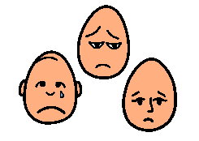
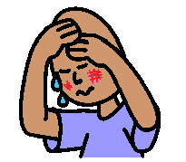
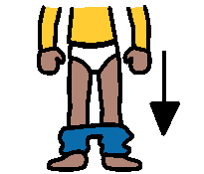
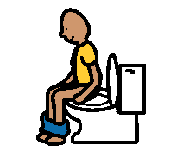
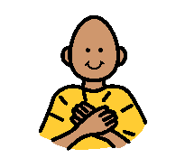
My friends don’t like to see me pull my pants down.
When I pull my pants down Mum is very sad.
Mum will say “It is very rude to pull your pants down”.
I am trying to remember to only pull my pants down when I go to the toilet.
Everyone is happy when I have good manners.
I feel happy too!

