Slide 1
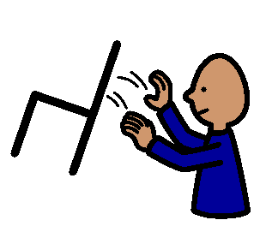
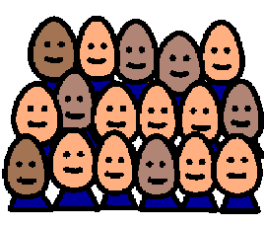
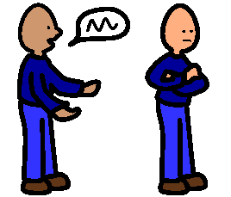
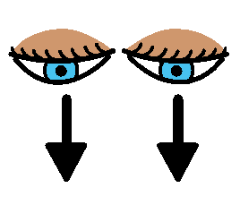
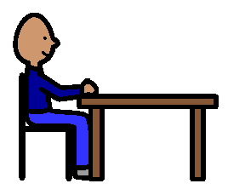
DOING THE RIGHT THING
Sometimes our classmates do the wrong thing.
They may do things like swearing or showing off,
screaming, yelling,
or unsafe things.
We do not give them an audience.
We try not to laugh at them or point,
nudge our neighbour, call out
or encourage them.
We try to ignore these behaviours
by keeping our eyes down and continuing to work,
staying in our seat and listening to our teachers.
Our teachers will be happy and say “well done”.

