Slide 1
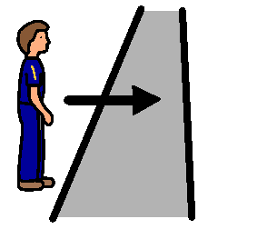
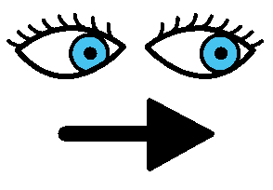
CROSSING THE ROAD
Walk to the edge of the road.
STOP
Look left to see if there are any cars coming.
Look right for cars.

Slide 2
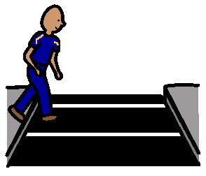
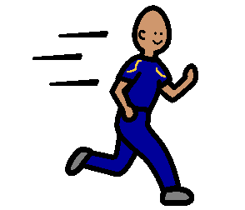
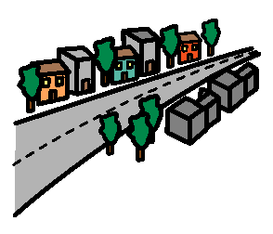
Look left again.
Walk, not run, across the road to the other side.
Now I can walk up the street.

