Slide 1
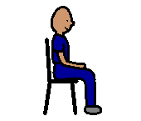
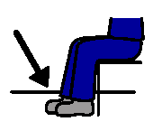
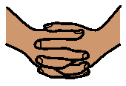
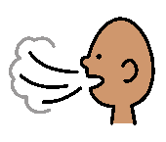
Calm Down
Sit on the chair
Feet on the floor
Fold hands
Take 3 deep breaths
1
3
5
7
2
4
6
9
Count to 10
8
10
Good work

