Slide 1
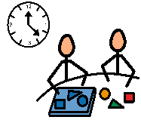
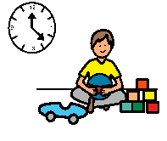
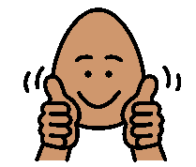
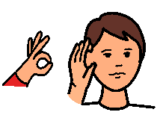
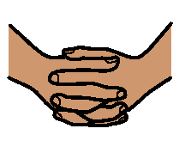
work time
play time
Good job!
Good listening!
stop
hands to self

Slide 2
These are a few symbols that can be laminated and worn around the neck to give your students visual tips on how they are doing with their behaviour expectations.

