Slide 1
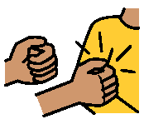
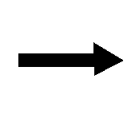
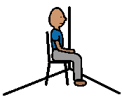
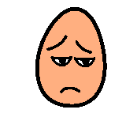
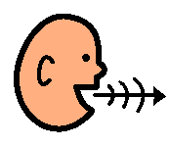
hit
time out
sad
use your words
Stay with kids
happy
BEHAVIOUR CONSEQUENCE STRIP: Print, cut out and mount back to back on the piece of paper or card, and then laminate. This behaviour strip shows the appropriate behaviour and consequence on one side and the inappropriate behaviour and consequence on the other side. The appropriate behaviour should be a positive example of what you want to see the child doing rather than something negative. Instead of “no picking nose” put “use Kleenex”.

