Slide 1
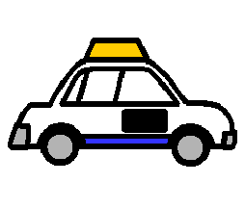
When Eddy gets out of the taxi
Insert student pic…

Slide 2
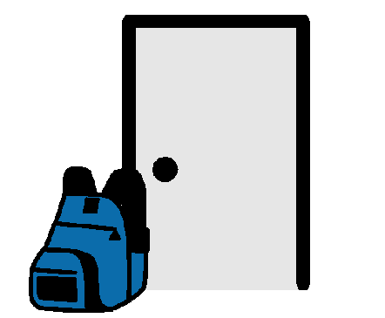
When Eddy gets out of the taxi in the morning he will put his school bag at the classroom door.

Slide 3
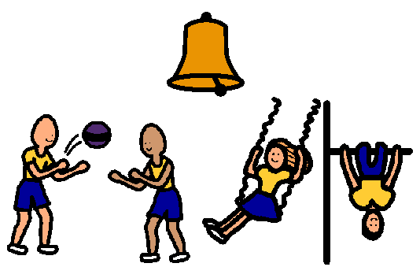
Eddy then plays in the playground until the bell rings.

Slide 4
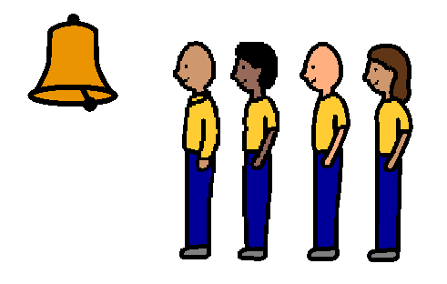
When the bell rings Eddy will line up with his class.

Slide 5
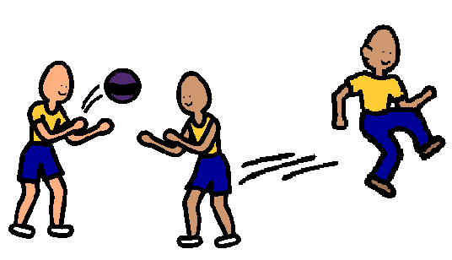
Eddy will then do fitness with his class.

Slide 6
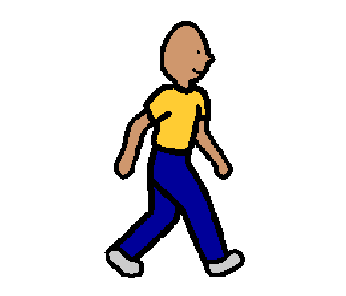
After fitness Eddy will walk to the classroom with his class and teacher.

Slide 7
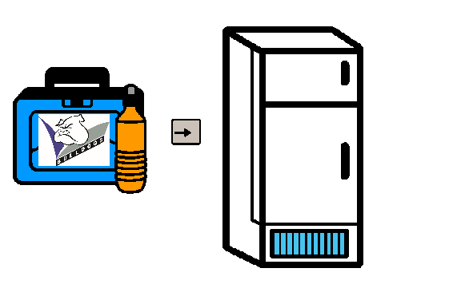
Eddy will then put his lunchboxes and drink bottle in the fridge.

Slide 8
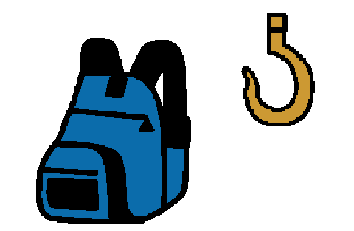
Eddy will hang his school bag on the hook.

Slide 9
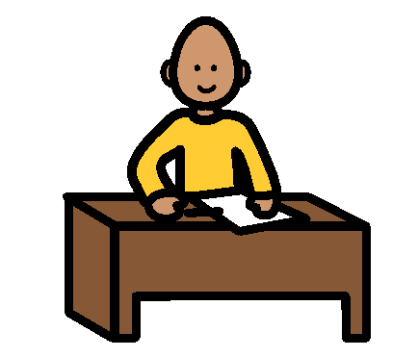
Eddy will then go into his classroom and sit down at his desk.

